Slide 1
EcoSynthetix Inc.
Q2 2016 Earnings Call
Jeff MacDonald | CEO
Robert Haire | CFO
August 11, 2016

Slide 2
FORWARD LOOKING STATEMENTS
Certain statements contained in this document and any amendment or supplement hereto constitute forward-looking statements. All statements other than statements of historical fact may be forward-looking statements. These statements relate to, but are not limited to, future events or future performance, our expectations regarding the Company’s growth, results of operations, estimated future revenues, requirements for additional capital, production costs, future demand for latex-based products, business prospects and opportunities. Forward-looking statements are often, but not always, identified by use of words such as “may”, “will”, “should”, “could”, “seek”, “anticipate”, “contemplate”, “continue”, “expect”, “intend”, “plan”, “potential”, “budget”, “target”, “believe”, “estimate” and similar expressions. Such statements reflect the Company’s current views and beliefs with respect to future events, are subject to risks and uncertainties, and are based upon a number of estimates and assumptions that, while considered reasonable by the Company, are inherently subject to significant business, economic, competitive, political and social uncertainties and contingencies. Many factors could cause actual results, performance or achievements to be materially different from any future results, performance, or achievements that may be expressed or implied by such forward-looking statements.
Specific forward-looking information contained in this document includes, among others, statements regarding: (i) the price of oil and SB Latex; (ii) the demand for the Company’s products including the Company’s ability to guarantee successful mill trials; (iii) the Company’s competitive advantages and ability to compete successfully; (iv) the nature and characteristics of the Company’s intellectual property; (v) the Company’s ability to expand production capacity; and (vi) general economic conditions.
With respect to forward-looking information contained in this document, the Company has made material assumptions regarding, among other things: (i) that the general business, economic and competitive conditions remain favourable; (ii) that our intellectual property rights are adequately protected; (iii) our ability to obtain the materials necessary for the production of our products; (iv) our ability to market products successfully to our customers; (v) that we will continue to face no direct competition; (vi) changes in demand for and prices of our products or the materials required to produce those products; (vii) labour and material costs remaining consistent with our current expectations; and (viii) that we do not and will not infringe third party intellectual property rights. Some of our assumptions are based upon internal estimates and analyses of current market conditions and trends, management plans and strategies, economic conditions and other factors and are necessarily subject to risks and uncertainties inherent in projecting future conditions and results.
Some of the risks that could affect the Company’s future results and could cause those results to differ materially from those expressed in the forward-looking information include: (i) an inability to protect, defend, enforce or use our intellectual property and/or infringement of third-party intellectual property; (ii) our dependence on certain customers and changes in customer demand; (iii) the availability and price of natural feedstocks used by us in the production of our products; (iv) the inability to effectively expand our production facilities; (v) variations in our financial results; (vi) increase in industry competition; (vii) the risk of volatility in global financial conditions, as well as significant decline in general economic conditions; (viii) our ability to effectively commercially market and sell our products; (ix) our ability to protect our know-how and trade secrets; (x) company growth and the impact of significant operating and capital cost increases; (xi) changes in the current political and regulatory environment in which we operate; (xii) the inability to retain key personnel; (xiii) changes to regulatory requirements, both regionally and internationally, governing development, production, exports, taxes, labour standards, waste disposal, and use, environmental protection, project safety and other matters; (xiv) enforcement of intellectual property rights; (xv) a significant decrease in the market price of petroleum; (xvi) a shortage of supplies, equipment and parts; (xvii) the inability to secure additional government grants; (xviii) a deterioration in our cash balances or liquidity; (xix) the inability to obtain equity or debt financing; (xx) the ability to acquire intellectual property; (xxi) the risk of litigation; (xxii) changes in government regulations and policies relating to our business; (xxiii) losses from hedging activities and changes in hedging strategy; (xxiv) insufficient insurance coverage; (xxv) the inability to expand technology; (xxvi) the impact of issuance of additional equity securities on the trading price of the Common Shares; (xxvii) the impact of ethical, legal and social concerns relating to genetically modified organisms and the food versus fuel debate; (xxviii) the risk of business interruptions; (xxix) lack of a public market; (xxx) fluctuations in the market price of the Common Shares; (xxxi) our intent to retain earnings; (xxxii) the costs of being a reporting issuer; (xxxiii) the company is a holding company; (xxxiv) tax risks; (xxxv) the impact of changes in interest rates; (xxxvi) the impact of changes in foreign currency exchange; and (xxxvii) credit risk. There may be other factors that cause actions, events or results not to be as anticipated, estimated or intended. These factors are not intended to represent a complete list of the risk factors that could affect us. Risk factors should be considered carefully and prospective investors should not place undue reliance on forward-looking information.
Should one or more of these risks or uncertainties materialize, or should assumptions underlying those forward-looking statements prove incorrect, actual results may vary materially from those anticipated in such forward-looking statements.
Although the forward-looking statements contained herein are based upon what the Company believes to be reasonable assumptions, the Company cannot assure that actual results will be consistent with these forward looking statements. Accordingly, readers should not place undue reliance on forward-looking statements.

Slide 3
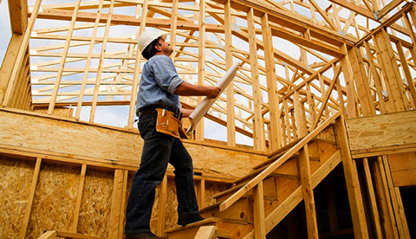
15B
$
global wood resin market

Slide 4
FORMALDEHYDE: A HAZARDOUS INGREDIENT IN WOOD COMPOSITE BINDERS
U
F
U
F
THE SEARCH FOR A VIABLE ALTERNATIVE WITHOUT FORMALDEHYDE (PERFORMANCE + VALUE)

Slide 5
JULY 27, 2016 – WASHINGTON - The U.S. Environmental Protection Agency (EPA) today moves to reduce exposure to formaldehyde vapors from certain wood products produced domestically or imported into the United States. One year after the rule is published, composite wood products that are sold, supplied, offered for sale, manufactured, or imported in the United States will need to be labeled as TSCA Title VI compliant. These products include: hardwood plywood, medium-density fiberboard, particleboard as well as household and other finished goods containing these products.
NEWS RELEASE EPA Issues Final Rule to Protect the Public from Exposure to Formaldehyde

Slide 6
“Wal-Mart Stores Inc. is asking suppliers to remove formaldehyde…from their products, part of an effort to eliminate controversial chemicals from household goods.
Bloomberg News
July 21, 2016

Slide 7
DURABIND: PERFORMANCE FOR MASS ADOPTION
1,100
$0.5M to $3M
wood composites lines
annual revenue opportunity per line
~10 LINES TO ACHIEVE CASH FLOW BREAKEVEN

Slide 8
WOOD COMPOSITE TRIAL PROGRESS
TOP 15 GLOBAL WOOD-BASED PANEL MANUFACTURERS
‘000 m³
4,000
8,000
12,000
16,000
Kronospan M&P Kaindl
Egger
>5
Swiss Krono Group
Arauco
Louisiana-Pacific
Sonae Indústria
Norbord
top 15 global wood composites manufacturers in trials
(representing >50 production lines)
Georgia-Pacific
Duratex
Pfleiderer
Weyerhaeuser
Kastamonu Entegre
Swedspan
Masisa
Finsa
PB
MDF
OSB
PIPELINE OF PROSPECTS EXPANDS AND ADVANCES
Source: Sonae Indústria investor presentation – February 2016
ECOSYNTHETIX INC.
8

Slide 9
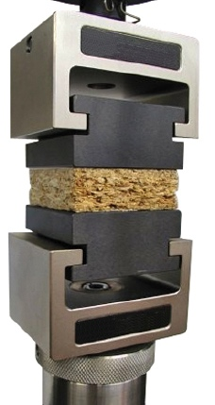
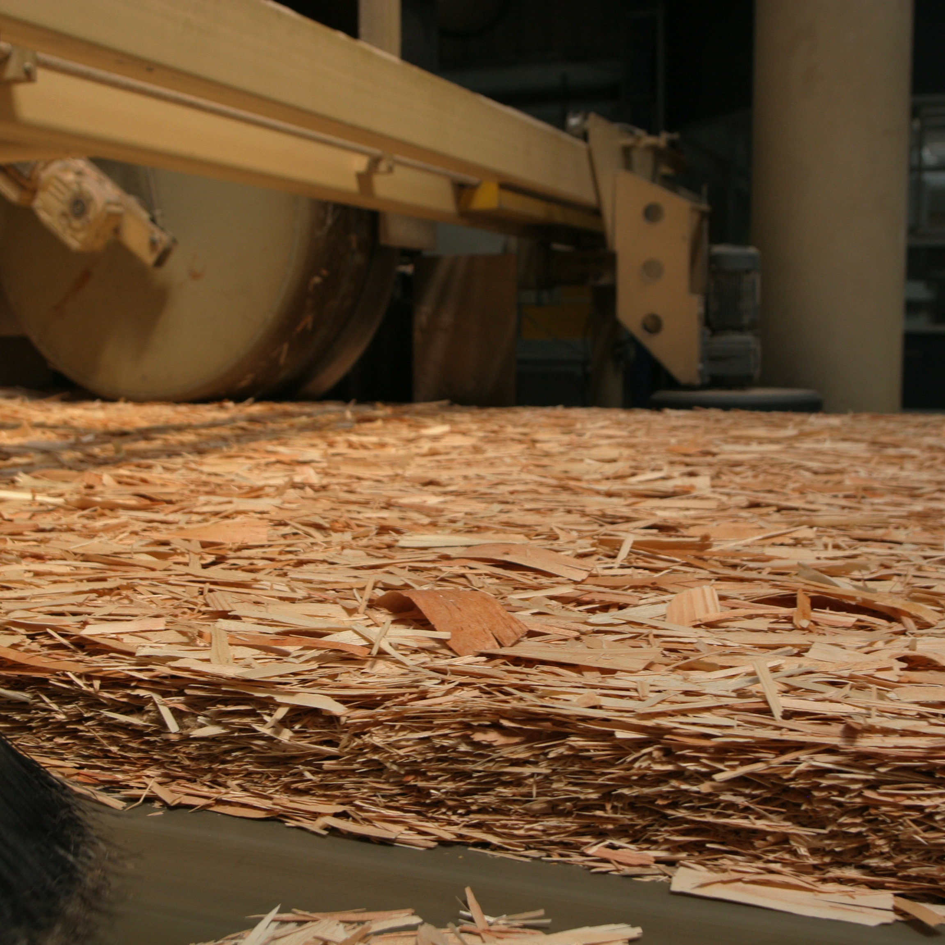
IMPORTANT MILESTONE APPROACHING: FIRST COMMERCIAL CUSTOMER
IB & MoR testing
PROCESS testing
FIRST COMMERCIAL CUSTOMER IS ONLY THE START

Slide 10
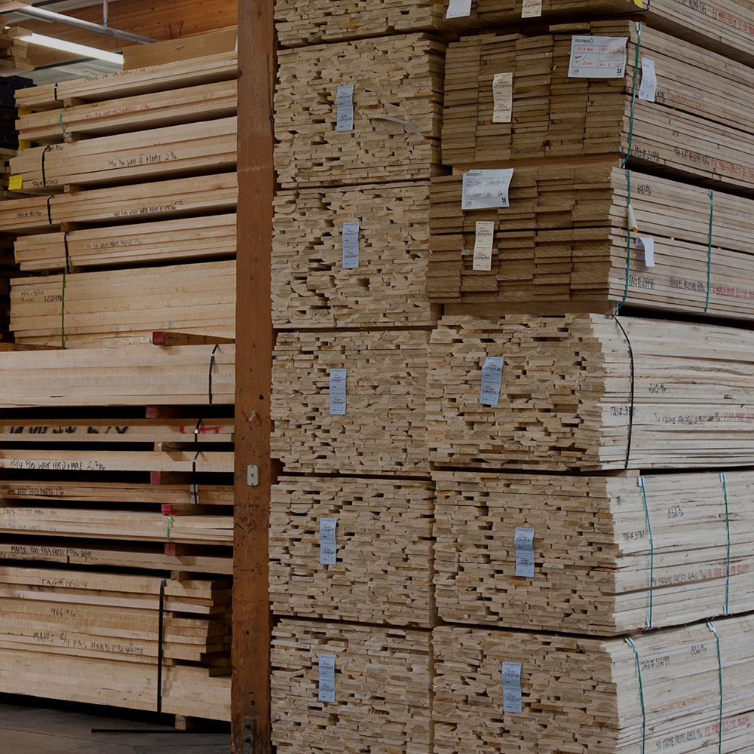
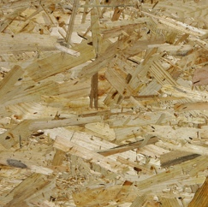
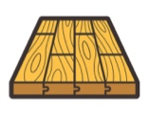
MASSIVE MARKET POTENTIAL FOR A NO ADDED FORMALDEHYDE LEADER
$15B Global Wood Resin Market
Oriented Strand Board
Medium Density Fiberboard
Particle Board
No Added Formaldehyde Market Share by Application
Source: Transparency Market Research Report

Slide 11
DURABIND VALUE PROPOSITION WILL ENABLE BROAD ADOPTION
LONGER PRODUCTION UP-TIME
Reduced blow-line blockage
LOWER PRODUCTION COSTS
Longer tool life
Lower use of costly processing aids
LESS WASTE
Larger processing window
BETTER QUALITY, HIGHER VALUE BOARDS
Market share & margin for our customers
PERFORMANCE
VALUE

Slide 12
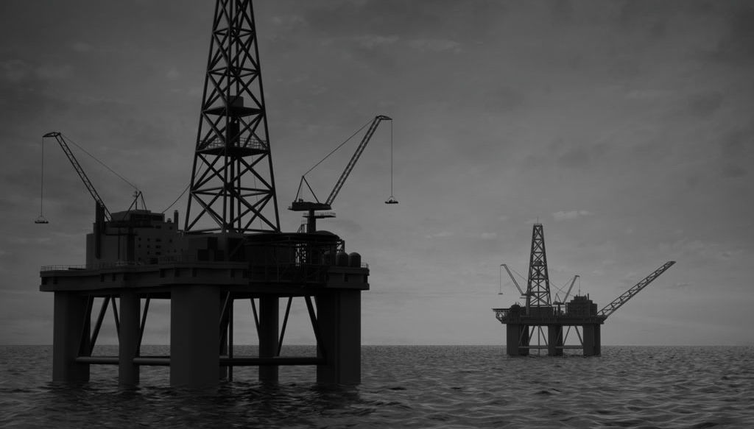
CHALLENGING PAPER MARKET CONDITIONS PERSIST
$87 SB latex/100 lb
$43 WTI/bbl

Slide 13
FINANCIALS
USD millions (except gross margin) | Q2 2016 | Q2 2015 | YTD 2016 | YTD 2015
Net Sales | $2.9 | $4.1 | $5.9 | $8.3
Gross Profit | $0.5 | $0.7 | $0.9 | $1.3
Gross Margin | 15.7% | 16.8% | 15.9% | 15.4%
Gross Margin adjusted for manufacturing depreciation | 22.3% | 22.8% | 22.6% | 20.6%
Adjusted EBITDA (loss) | ($2.3) | ($2.0) | ($4.4) | ($5.8)
1) Adjusted EBITDA is defined as consolidated net income (loss) before interest, income taxes, depreciation, amortization, impairment loss on PP&E, and other non-cash charges deducted in determining consolidated net income (loss).

Slide 14
OPERATING COST
Selling, General & Administrative
(USD, millions)
Research & Development
(USD, millions)
Selling, general and administrative expenses and research and development expenses excludes share-based compensation, depreciation and amortization, provision for termination benefits and foreign exchange gains and losses
STRICT FINANCIAL DISCIPLINE WITH TARGETED INVESTMENT IN HIGH GROWTH AREAS

Slide 15
OUR FUNDAMENTALS
CAPITAL TO EXECUTE COMMERCIAL STRATEGY IN WOOD COMPOSITES
RETAINING A BASE BUSINESS IN PAPER OF ~$3M/QTR DESPITE HEADWINDS
FOCUSED RESOURCES IN WOOD COMPOSITES
57M
US$
cash & term deposits (June 30, 2016)
STREAMLINED OPERATIONS WITH STRONG BALANCE SHEET

Slide 16
DURABIND: NO ADDED FORMALDEHYDE …NO PROBLEM!
EPA INCREASING REGULATION
WALMART & IKEA WITH GOALS TO ELIMINATE
TRIAL PIPELINE EXPANDING AND GROWING
EXPECT FIRST CUSTOMER IN NEAR TERM
OBJECTIVE: TRANSFORM THE WOOD COMPOSITE RESIN MARKET WITH OUR PROPRIETARY, SUSTAINABLE NAF SOLUTIONS

Slide 17
POSITIONED TO BECOME LEADING NO ADDED FORMALDEHYDE SOLUTIONS COMPANY
Passion for green chemistry
>5/15
>20
global patent families
50
experienced team members
US$57M
cash & term deposits with no debt
235M
lbs production capacity
top global wood composites manufacturers in trials

Slide 18
CORPORATE OVERVIEW
TSX Symbol | ECO
Shares Outstanding (includes put/call shares) | 59,289,214
Market Capitalization (as at Aug 10, 2016) | CDN $103.2M
Net Debt | Nil
Cash Balance (as at June 30, 2016) | USD $57.4M / CDN $75.3M

Slide 19
EcoSynthetix Inc.
Question & Answer

